Slide 1
Latent variable models
Session 1 – Introduction and path models

Slide 2
Dr. Julian Karch
Methodology and Statistics Unit
Leiden University
Room 3B15
j.d.karch@fsw.leidenuniv.nl
Notes:
Introduction
Who are you?
And why are you here?

Slide 3
Class outline
General administrative stuff
Introduction to structural equation modeling (SEM)
Selected topics from chapter 2 of Beaujean
Exercises / lab session

Slide 4
Course schedule
 | Monday 03.07. |  | Tuesday 04.07. | Thursday 05.07.
10:00-13:00 | Introduction / path models |  | Latent growth curve models | Measurement invariance / multiple group models
13:00-13:30 | Lunch break
13:30-16:30 | Confirmatory factor analysis | Confirmatory factor analysis 2: non-continuous data |  | Miscellaneous

Slide 5
Course prerequisites
Knowledge of statistics
Statistical testing (e.g., chi-square & normal distributions)
Regression (GLMs)
Var, cov, cor, mean
Knowledge of psychometrics
Validity
PCA, EFA, CFA
Reliability
IRT
Matrix algebra
Addition, multiplication, diagonal, inverse
Programming in R

Slide 6
Course materials
Beaujean, A. A. (2014). Latent variable modeling using R: A step-by-step guide. Routledge.
R code for book’s examples available on web
http://blogs.baylor.edu/rlatentvariable/sample-page/r-syntax/
Also available in annotated code files on github
Lecture sheets on github
Annotated code files on github ( .pdf)
If you prefer to have multiple resources: lavaan’s tutorial is concise and helpful
lavaan.ugent.be/tutorial/index.html

Slide 7
Structural Equation Modeling
SEM: the modeling of structural equations
Modeling: we are constructing models (hypotheses, theories) of reality. The models (theory, hypothesis) can be statistically rejected by the data (or not), but never proven ‘true’ or ‘right’.
In fact, all models are wrong, but some are useful approximations to reality. So the p-value does not decide whether a model is right or wrong, only the researchers and users can decide which models are useful
Structural: the model is used to explain the interrelations between (the structure of) observed variables
In other words, explain the values of endogenous variable using the exogenous variables
Equations: the interrelations between variables in the model are described using mathematical formulae (equations)

Slide 8
Structural Equation Modeling
The model of reality can be graphically represented using:
Observed (manifest) variable
Directional relationship (regression relationship)
Non-directional relationship
(correlation/(co)variance)
Latent variable
Constant (not a variable)

Slide 9
Structural Equation Modeling
The arrows in SEM denote regression relationships, of the linear type
Therefore, all generalized linear models (GLMs) can also be formulated as SEM models, e.g.,
t-test
ANOVA
Multiple linear regression
Multiple logistic regression
…..
Also, SEM can be used to estimate random-effects (multi-level) models

Slide 10
Example dataset
Variables in the model:
GPA in 10th grade
Ethnicity
Homework (8th grade)
Previous achievement (8th grade)
Socio-economic status
grade
ethnicity
homework
SES
Prev_ach

Slide 11
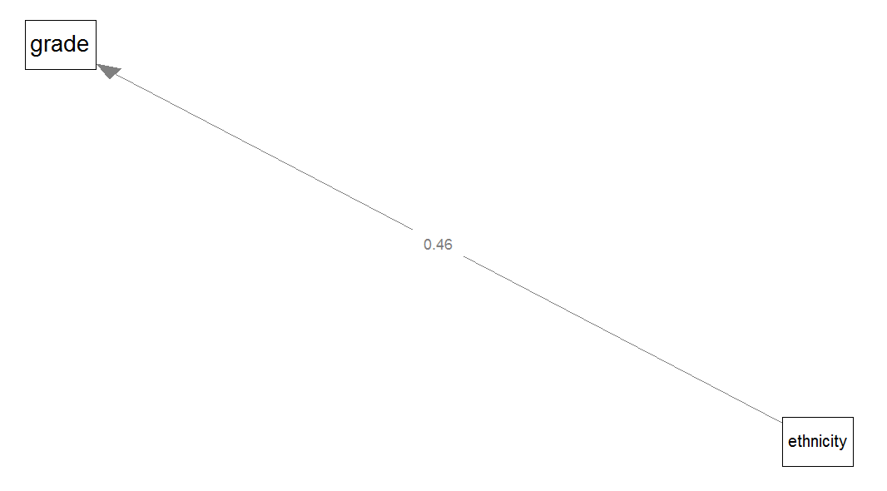
Model: t-test
Dependent variable
grade point average (GPA) in 10th grade
Independent variable
ethnicity (0=black, native american or hispanic; 1=white or asian)
Assess model fit:
Only one predictor, so only one parameter estimate:
Mean difference = .46, cor = .132, or η² = .017

Slide 12
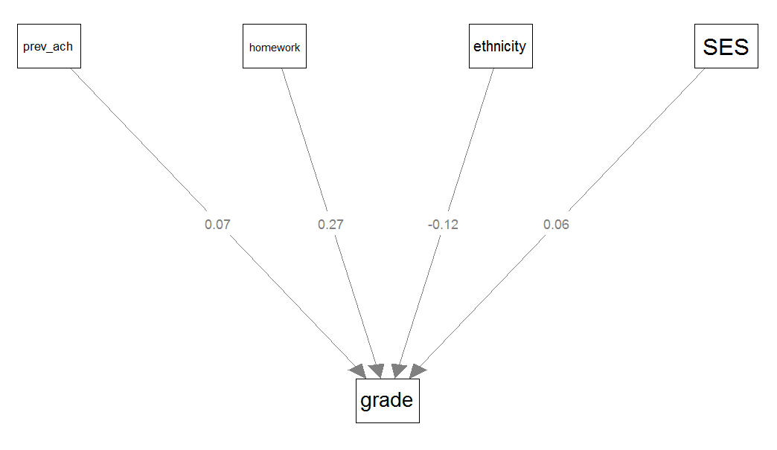
Model: multiple regression
Dependent variable
GPA in 10th grade
Independent variables
Ethnicity
Homework (8th grade)
Previous achievement (8th grade)
Socio-economic status
Assess model fit:
Multiple predictor variables, so:
Specific parameter estimates: betas, or standardized betas
‘Overall’ model fit: multiple correlation (R = .512), or variance explained (R² = .262)

Slide 13
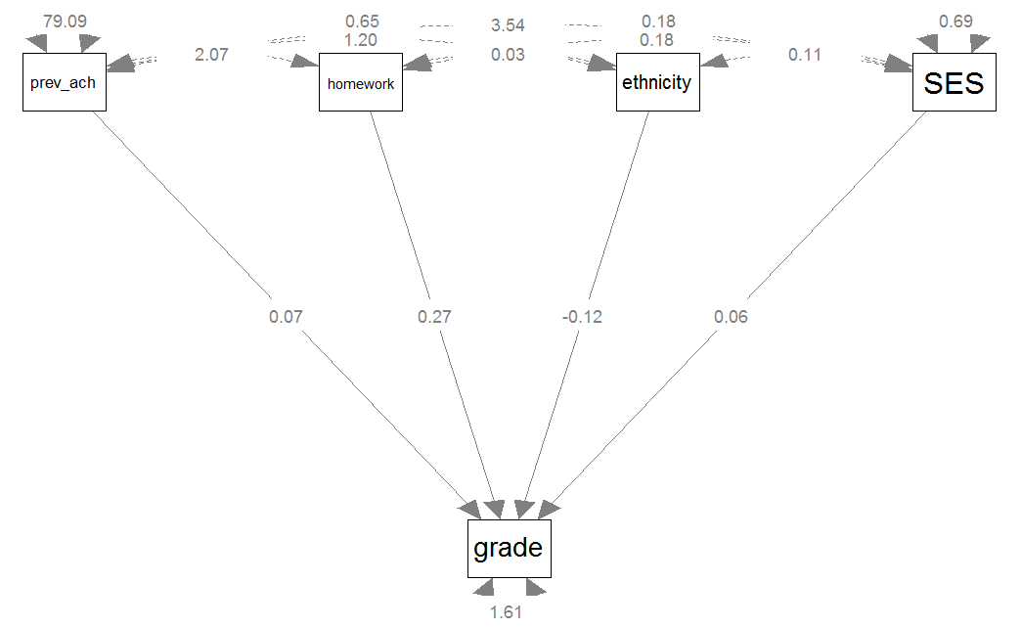
Model: SEM
Dependent variable
GPA in 10th grade
Independent variables
Ethnicity
Homework (8th grade)
Previous achievement (8th grade)
Socio-economic status
Evaluate:
Specific parameter estimates (e.g., regression coefficients, error variances)
Overall model fit (e.g., chi-square value, fit indices)

Slide 14
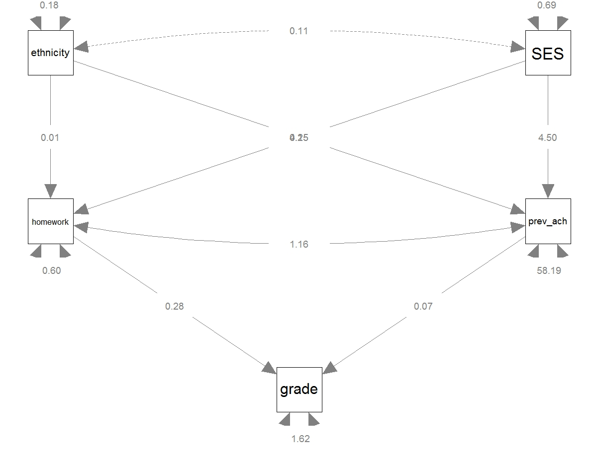
Model: SEM
Endogenous variables
Homework (8th grade)
Previous achievement (8th grade)
GPA in 10th grade
Exogenous variables
Ethnicity
Socio-economic status
Evaluate:
Specific parameter estimates (e.g., regression coefficients, error variances)
Overall model fit (χ²(2)=2.169; p =.338; CFI = 1.000; RMSEA = .009)

Slide 15
Terminology: SEMs vs GLMs
ANOVA, t-tests | Independent variable Factor | Dependent variable
Regression | Independent variable Predictor variable X | Dependent / criterion / response / outcome variable Y
SEM | Exogenous variable Variable that is used to explain other variables in the model X | Endogenous variable Variable that is explained by other variables in the model X
In this course, we mostly refer to all observed variables as X variables: X is ‘the observed data’. ‘X’ and ‘Y’ will only be used to denote two variables that are not the same.

Slide 16
Structural Equation Modeling
The model is used to explain the structure of, or the interrelations between the observed variables
More specifically, to explain covariances between observed variables:
A covariance matrix contains all (co)variances of the observed variables in the model

Slide 17
Structural Equation Modeling
Every model with fixed parameters implies a covariance matrix
With SEM, we try to find the model that minimizes the difference between the matrix of observed covariances (S) and the matrix of model-implied covariances ( ).
In addition, we try to keep the model parsimoneous (more about that when we discuss model fit)

Slide 18
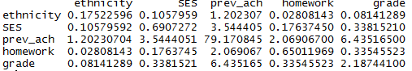
Explaining (co)variances: example
Variables in the model:
Observed covariance matrix S (calculated from X using formulas on previous slides):
grade
ethnicity
homework
SES
Prev_ach

Slide 19
Path analysis: tracing rules correlations
In a standardized model model-implied correlations between variables X and Y are calculated as follows:
Find all paths leading from X to Y
Multiply all parameter values along a given path from X to Y, but:
Can start going backwards and switch to foward but never switch from forward to backward
May not go through same variable more than once
May go through double-headed arrow only once within a path
Summing all the values thus obtained

Slide 20
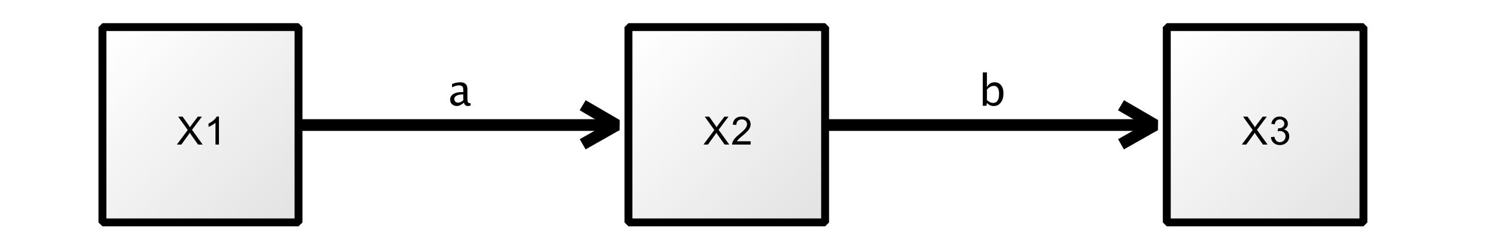
Example

Slide 21
Path analysis: tracing rules covariance
In an unstandardized, model model-implied covariances between variables X and Y are obtained with the same rules plus the addons:
Start tracing backwards, change direction at a two-header arrow, then trace forward
Sum over all unique routes (unique sequence of coefficients)
Variances of variables are calculated as follows:
For exogenous variables, variances are model parameters, so do not need to be calculated
For endogenous variables, variances are calculated like covariances
Notes:
Give handouts

Slide 22
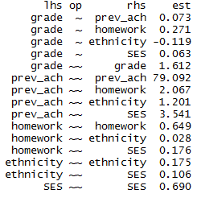
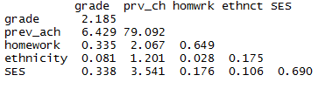
Model-implied covariances
Model:
Model-implied covariance matrix :
Notes:
Homework – prev_ach + wrong paths (rule 3)
Prev_arch – grade 0.07*79.09=

Slide 23
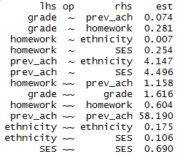
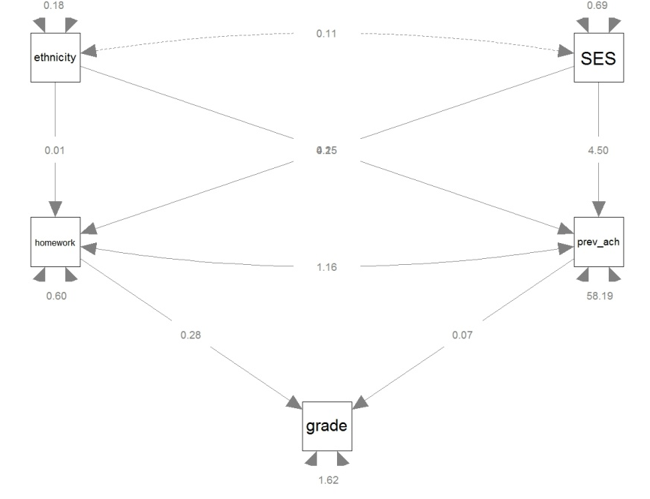
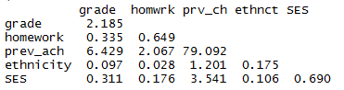
Model-implied covariances
Model:
Model-implied covariance matrix :

Slide 24
Model-implied covariances
Cov(SES,grade)=
b(prev_ach,grade)*b(SES,prev_ach)*var(SES) +
var(SES)*b(SES,homework)*b(homework,grade) +
cov(SES,ethnicity)*b(ethnicity,homework)*b(homework,grade) +
cov(SES,ethnicity)*b(ethnicity,prev_ach)*b(prev_ach,grade) = 0.311

Slide 25
Structural Equation Modeling
… interrelations between variables in the model are described using mathematical formulae …
Equations and associations in SEM are of the linear kind
addition of variables and/or constants, multiplication by constants
Non-linear SEM does exist, but is much less common, and outside the scope of this course
Beaujean’s book hardly involves formulas, and no matrix notation. To get a good understanding of SEM, knowledge of the underlying matrices and vectors is useful (and provides a simpler representation than path analysis)

Slide 26
Matrices of a SEM
A SEM model consists of several matrices of parameters
Let P be the number of observed variables in the model
In the earlier examples (involving observed variables only), we have
β: a PxP matrix of regression coefficients, relating predictor to criterion variables
‘Contains’ single-headed (directed) arrows, therefore non-symmetric
Ψ: a PxP matrix of (co)variances not explained by the regression equations
‘Contains’ double headed (undirected) arrows, therefore symmetric
β and Ψ describe the structural model
Often, SEM models also involve a measurement model (described by Λ and Θ; introduced in the afternoon)

Slide 27
Structural and measurement model
Two main components of SEMs are distinguished
the structural model showing potential causal dependencies between endogenous and exogenous variables
path diagrams can be viewed as SEMs that contain only the structural part
the measurement model showing the relations between latent variables and their indicators
exploratory and confirmatory factor analysis models contain only the measurement part

Slide 28
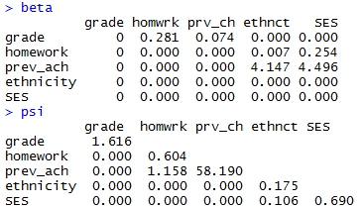
Structural model (no measurement model)
Notes:
Psi: symmetric
Beta: non-symmetric. If A ~ B, then A is on row, B is on column

Slide 29
Some matrix algebra
In lavaan, all SEMs are defined by four parameter matrices (which give the model-implied covariance matrix sigma_hat):
Today, our models involve no measurement part, this simplifies to:
Equation above is exactly the same thing as using tracing rules to calculate model-implied (co)variances
with many variables, path analysis becomes tedious and error prone

Slide 30
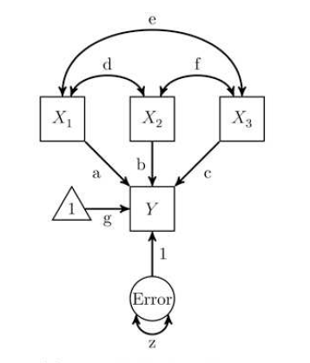
Endogenous vs exogenous variables
Exogenous variables have no direct cause in the model
from Greek exo, meaning ‘outside’, and gignomai, meaning ‘to produce’
No incoming, only outgoing directional arrows
Endogenous variables have a direct cause in the model
From Greek endo, meaning ‘inside’
At least one incoming directional arrow

Slide 31
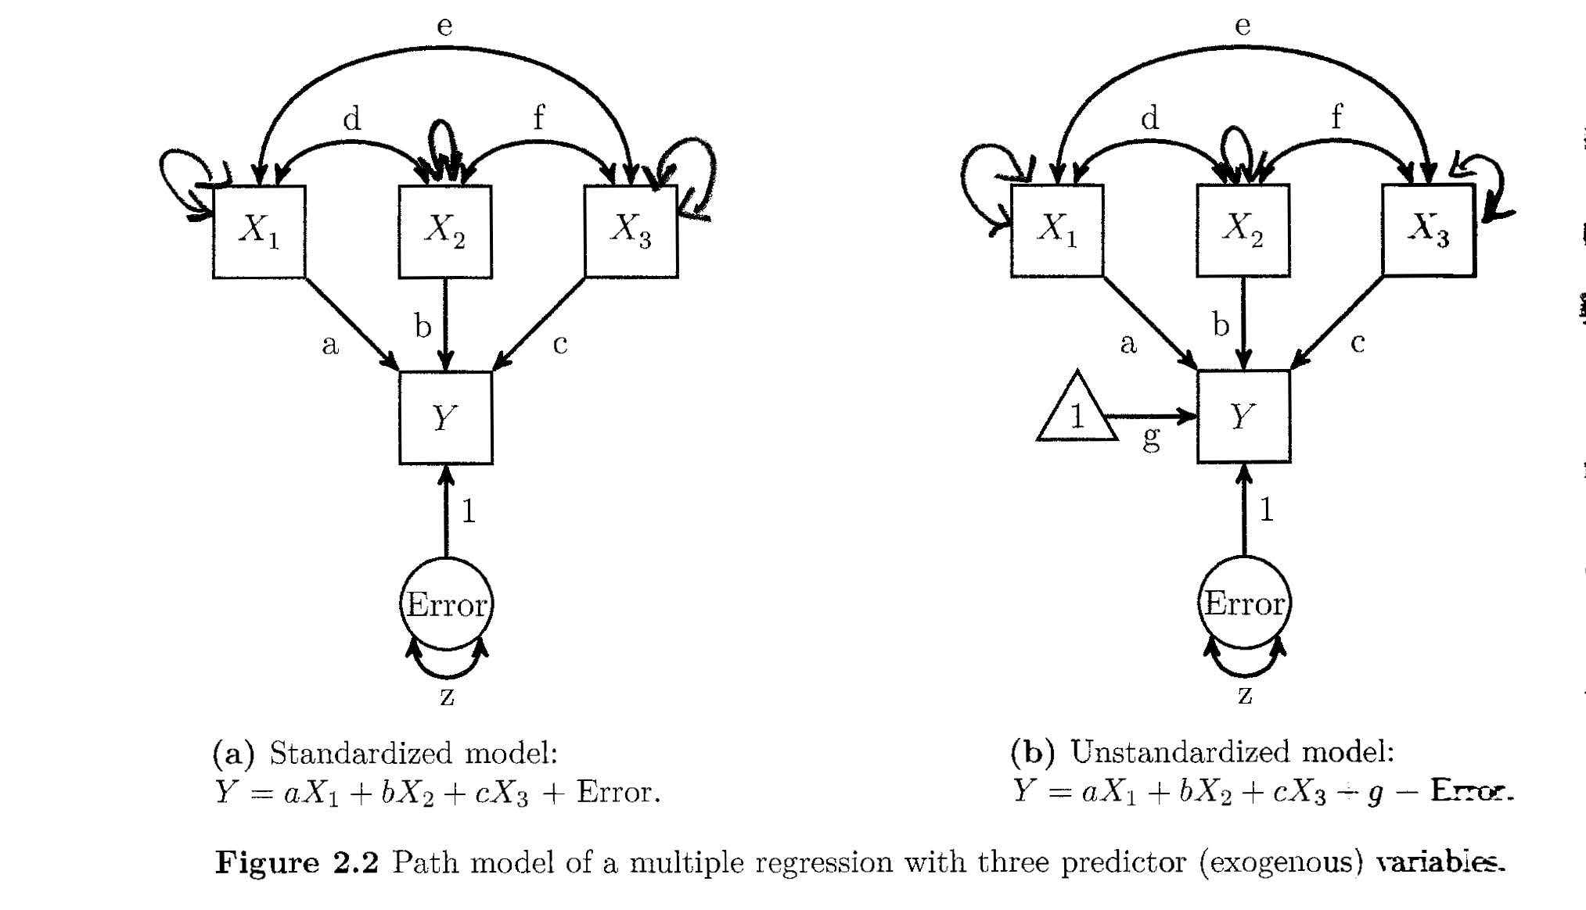
(error) variances often not explicitly depicted

Slide 32
Error terms
Errors are latent variables: they are hypothetical, not directly observed
Error is defined as the difference between observed variance and variance explained by other variables in the model
Errors are always exogenous (no incoming directional arrows)

Slide 33
Causation
Causation is a function of the research design, and cannot be determined statistically
Both models above will fit the observed data equally well, it is up to the researcher to decide on the direction of the arrows
But note that the estimated regression coefficient will be different in each model, as it depends on the scale of the exogenous and endogenous variables
error
X
Y
error
Y
X

Slide 34
Path & partial regression coefficients
Path coefficients (a, b, c and also g and 1) are partial regression coefficients
That is, the expected increase in the endogenous variable, when the variable increases by 1, controlling for (= keeping constant) all the other variables affecting that endogenous variable

Slide 35
Standardized coefficients
Path coefficients can be standardized and unstandardized
Standardized coefs can be interpreted like correlation coefficients (i.e., 0 is no linear association, min = -1 and max = 1, coef² = prop of variance explained)
Standardized coefficients are obtained in the same way as correlation coefficients in univariate regression:

Slide 36
Parameter estimation
So, a (centered, observed variables only) SEM consists of matrices β, Ψ with to be estimated parameters
How are these estimated?
In most cases (default in lavaan): maximum likelihood (ML) estimation
‘Maximum-likelihood estimator’ is ‘meest aannemelijke schatter’ in Dutch
More about that later in the course

Slide 37
SEM using lavaan
To fit a SEM model with lavaan, we basically need two things (R objects):
Data, which can be:
A raw dataset, which is often an external file (e.g., .sav, .xls) which needs to be turned into an R object
Or a covariance matrix, which can be an external file, or can be entered manually (most often the case in the book’s examples and exercises)
Model:
A long character string that specifies a model in lavaan syntax

Slide 38
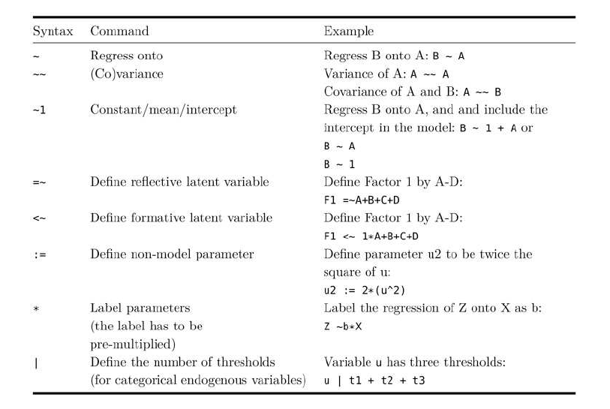
Lavaan model syntax

Slide 39
Lavaan model syntax

Slide 40
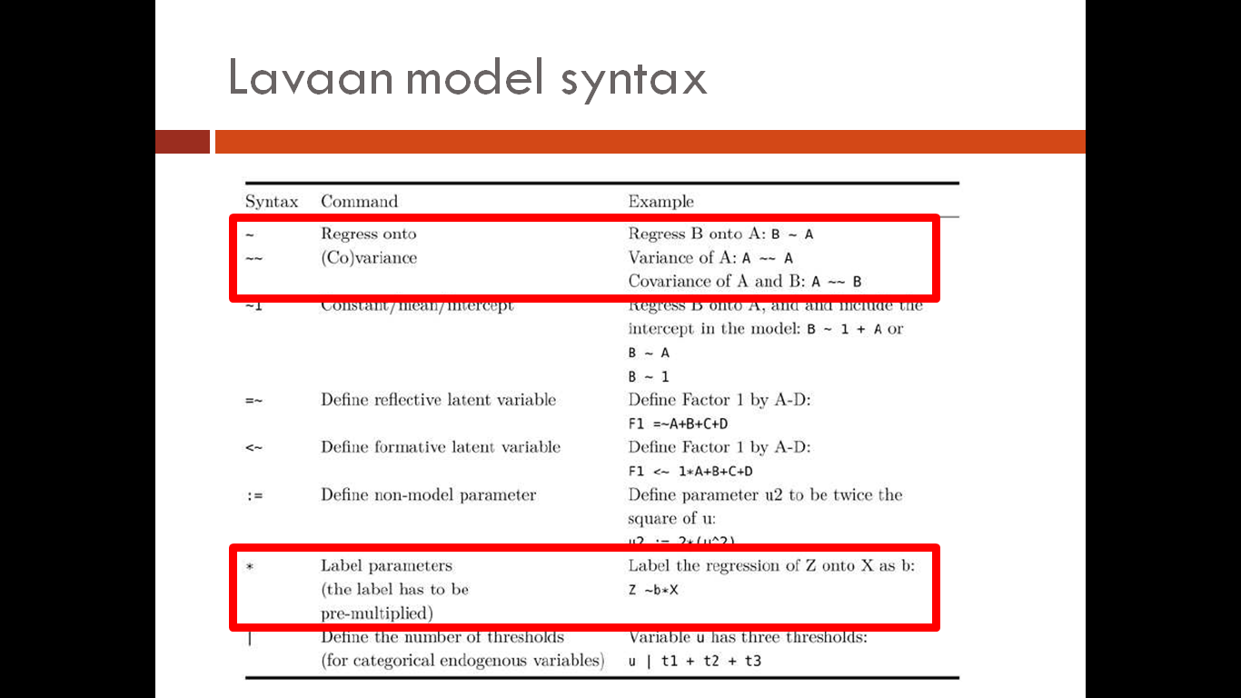
Lavaan model syntax
Note that errors are (the only) latent variables that do not have to be defined explicitly
By default, any endogenous variable (e.g., B in the first example above) gets an associated error variable with a path coefficient of 1, and the variance of the error variable is freely estimated
Covariances between exogenous variables are automatically included
To set to zero manually, multiply by zero, e.g.:
A ~~ 0*B

Slide 41
Lavaan Examples

Slide 42
Exercises
See https://github.com/marjoleinF/LVMbasic
Password: lav
Notes:
Give them password
Who does not have the book?

